Slide 1
CSE 2451 Linked List
Zichen Zhang

Slide 2
Overview
Data structure
Linked list
Linked list node struct
Create node
push number to front of the list
pop number from front of the list
Print list
Delete list
Return node via index
Insert node via index
Remove node via index
Potential issues

Slide 3
Data structure
Data structure is a collection of data values, the relationships among them, and the functions or operations that can be applied to the data
Linked list
Tree
Hash table
Graph
Enables efficient access and modification of the data
C doesn’t have built-in common data structures
We need to implement our own data structures

Slide 4
Linked list
A list of nodes
Each node contains some data
Each node is linked to the next node
A pointer to the next node
65
73
42
18
98
NULL

Slide 5
Linked list vs array
Linked list
Elements can be stored in scattered memory blocks (in program’s address space)
Flexible to insert or delete elements in the list
Slower access to an element via specified index (need to traverse from the front of the list to the specified node)
Array
Elements are stored in consecutive memory blocks (in program’s address space)
Inserting or deleting certain elements in array is slower
Faster access to the elements via array indexing
65
73
42
18
98
NULL
65
73
42
18
98

Slide 6
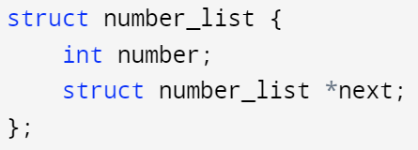
Define a node struct for the linked list
Keep in mind that our struct could store a lot more information, not just a single number
65

Slide 7
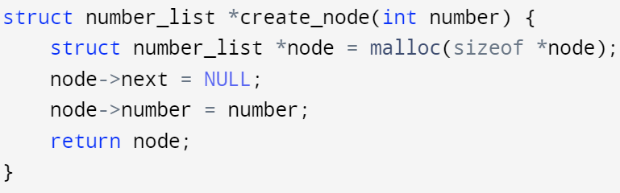
Create node of the linked list
Using a function to create node with dynamic memory allocation
98
NULL

Slide 8
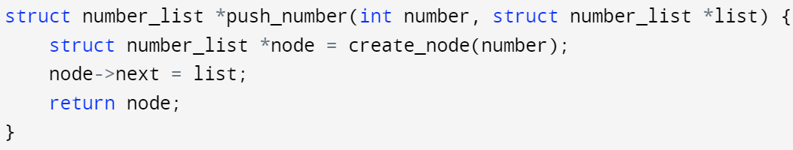
Push number to the front of the list
Create a new node, and make it the front node, then return its address
98
65
98
NULL
NULL

Slide 9
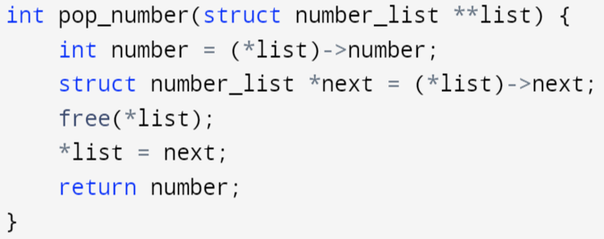
Pop number from the front of the list
Removing the front node, and free the associated memory, return the popped number, and keep the pointer to the front of the list updated to the new front node
*list
65
98
*list
98
NULL
NULL
Why a double pointer?

Slide 10
Pop number from the front of the list
Removing the front node, and free the associated memory, return the popped number, and keep the pointer to the front of the list updated to the new front node
*list
65
98
*list
98
NULL
NULL
We need to change the address stored in the single pointer to the front node of the list to its next node, in order to remove the front node

Slide 11
Pop number from the front of the list
Removing the front node, and free the associated memory, return the popped number, and keep the pointer to the front of the list updated to the new front node
*list
65
98
*list
98
NULL
NULL
Access the single pointer, and fetch the number that we want to pop out

Slide 12
Pop number from the front of the list
Removing the front node, and free the associated memory, return the popped number, and keep the pointer to the front of the list updated to the new front node
*list
65
98
*list
98
NULL
NULL
Save the address of the new front node in the list

Slide 13
Pop number from the front of the list
Removing the front node, and free the associated memory, return the popped number, and keep the pointer to the front of the list updated to the new front node
*list
65
98
*list
98
NULL
NULL
Free the memory block of the old front node of the list

Slide 14
Pop number from the front of the list
Removing the front node, and free the associated memory, return the popped number, and keep the pointer to the front of the list updated to the new front node
*list
65
98
*list
98
NULL
NULL
Update the single pointer to the front node of the list:
Make it to point to the new front node of the list

Slide 15
Pop number from the front of the list
Removing the front node, and free the associated memory, return the popped number, and keep the pointer to the front of the list updated to the new front node
*list
65
98
*list
98
NULL
NULL
Return number value of the old front node, i.e., pop number

Slide 16
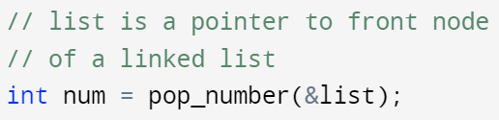
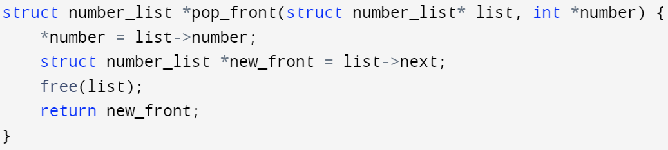
Pop number from the front of the list
Double pointer version:
Return popped node’s value
Modify single pointer to the front node directly
Single pointer version:
Return new front node’s address
Return popped node’s value via a pointer (bypass multiple return values limit in C)

Slide 17
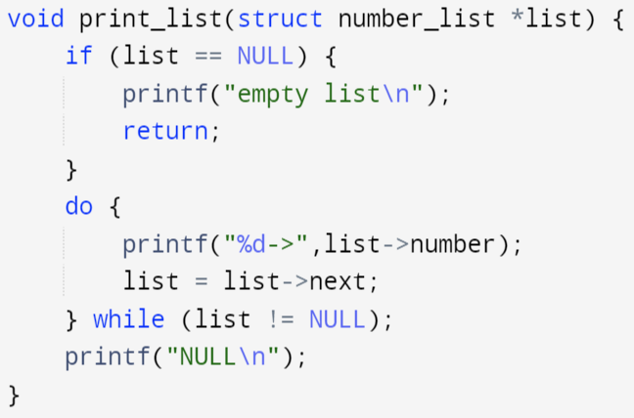
Print the numbers stored in linked list
Traversing from the front node of the list to its rear end
Last node’s next member == NULL

Slide 18
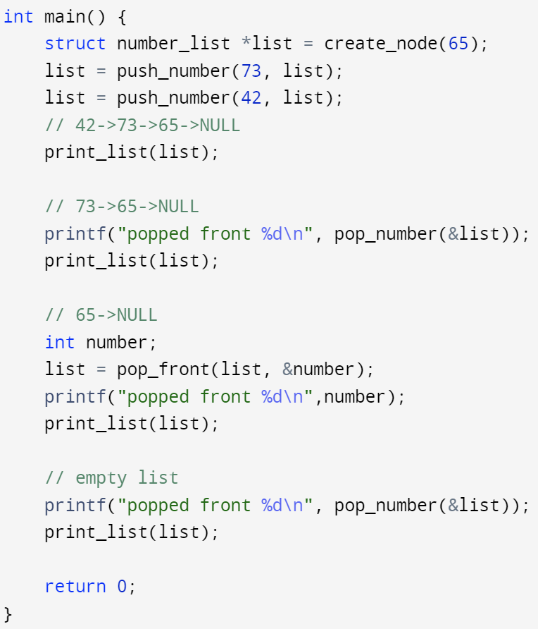
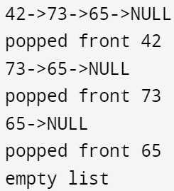
Linked list – example
Free of memory allocation happened inside the pop_number()/pop_front() functions

Slide 19
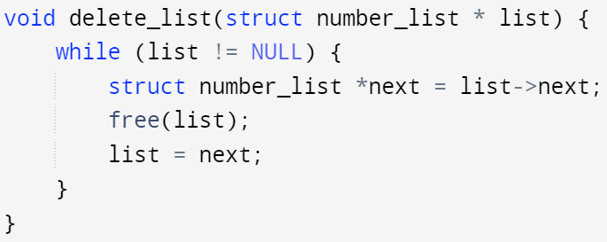
Delete/free the linked list
Remember, C has no garbage collection, we need to free dynamically allocated memory on our own
We could also implement delete_list() by repeatedly calling pop_number() or pop_front() function until all nodes are popped out of the list

Slide 20
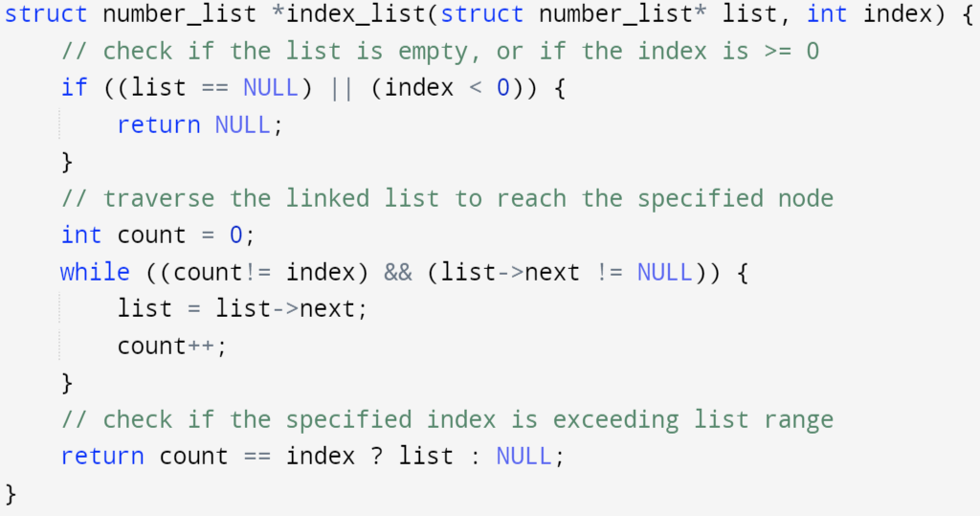
Return a node in linked list via its index
Recall the ternary operator (A ? B : C): if A is true, return B, otherwise return C
Check if input arguments are valid
Traversing through the linked list until reaching:
Specified index
End the linked list
If index is out of the valid range of the linked list, return NULL, otherwise return address stored in list (node at specified index)

Slide 21
Inserting a number/node in the list
65
73
42
18
98
index
0
1
2
3
4
NULL
Insert number 100 at index 2:
65
73
100
42
18
98
index
0
1
2
3
4
5
NULL

Slide 22
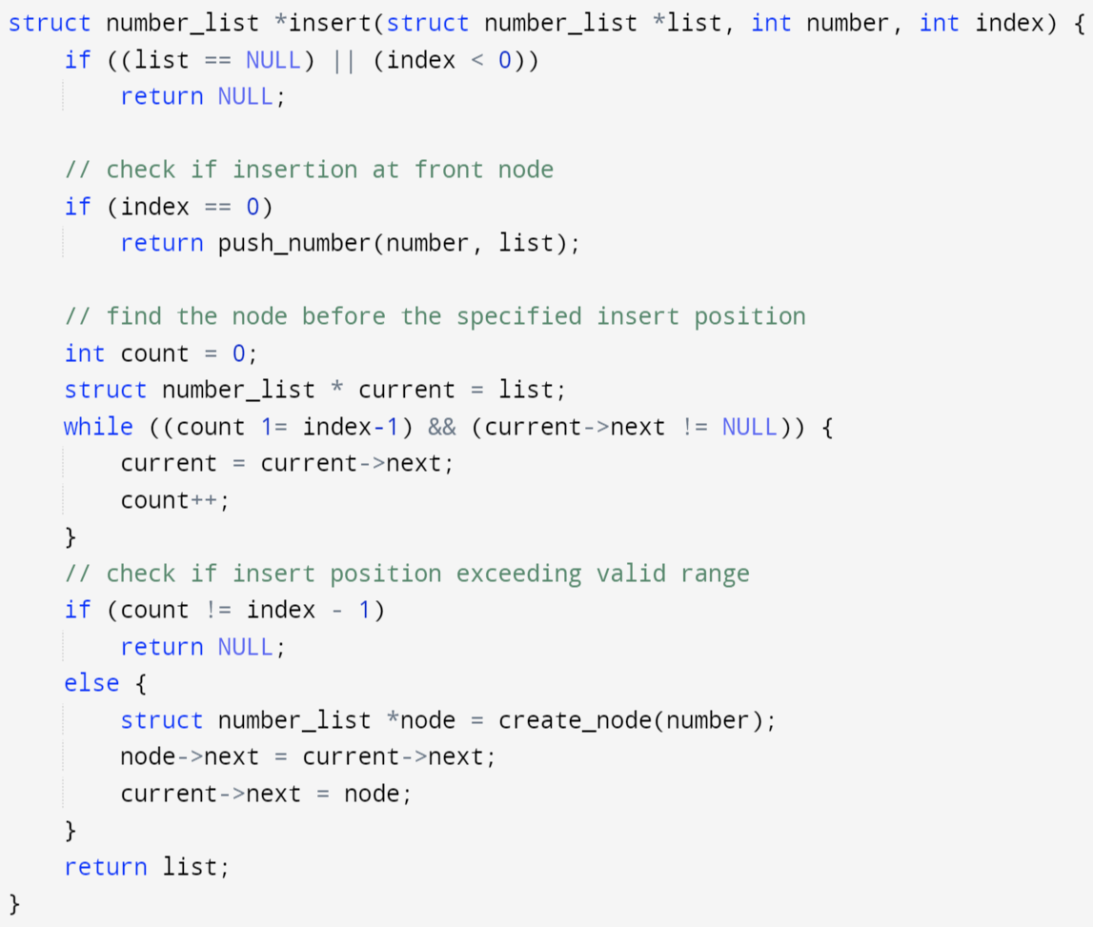
Inserting a number/node in the list
Takes address of the list’s front node
Takes a number you want to save in the inserted node
Takes an index specifies where you want to insert the node
Returns the front node’s address if insertion succeeds
Returns NULL if insertion fails
Check input validity
Call existing method if insertion at front node
Locate the node BEFORE the insertion
Insert the node if its index is not exceeding valid range of the list

Slide 23
Remove a number/node in the linked list
remove node at index 2:
65
73
100
42
18
98
index
0
1
2
3
4
5
65
73
42
18
98
index
0
1
2
3
4
NULL

Slide 24
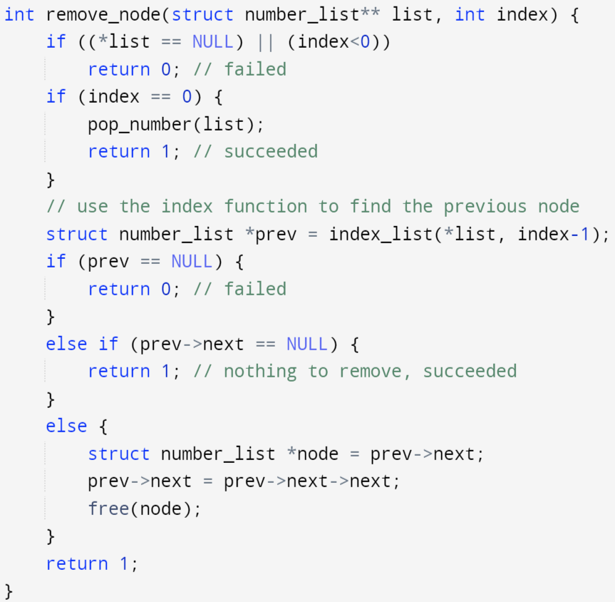
Remove a number/node in the linked list
Takes a double pointer pointing to the single pointer which stores the address of the list’s front node
Takes an index, specifies which node to remove
Return an integer: 1 → succeeded, 0 → failed
We need double pointer since we want to modify the address stored in the single pointer pointing to the front node (when removing the front node)
Check input validity
Call existing method if removing front node
Call existing method to locate the node BEFORE the target removal node

Slide 25
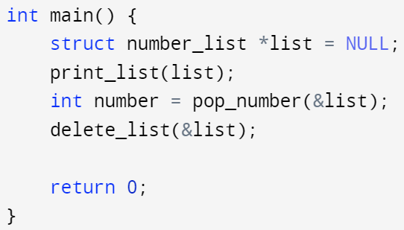
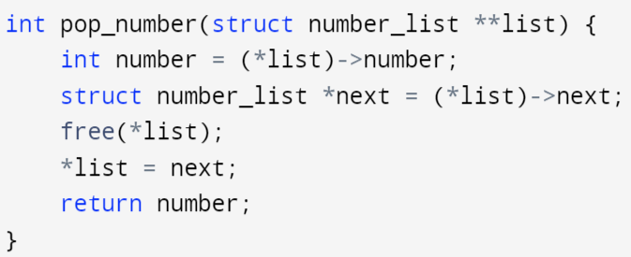

Potential issues and improvements
What happens if pop_number() is called on NULL? (empty list)
(*list) == NULL, accessing the number member via pointing-to operator on NULL → undefined behavior

Slide 26
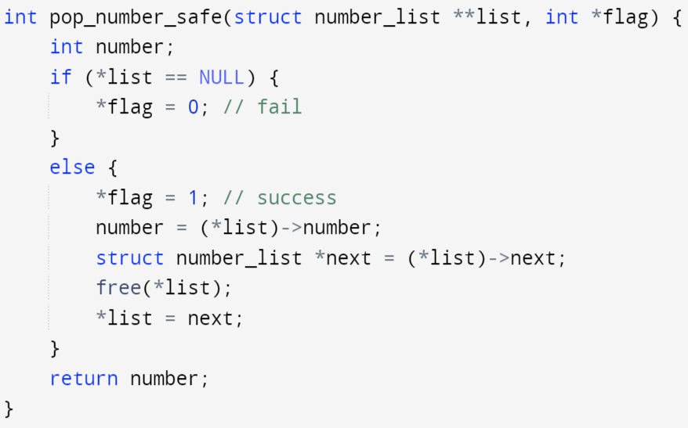
Potential issues and improvements
What happens if pop_number() is called on NULL? (empty list)
(*list) == NULL, accessing the number member via pointing-to operator on NULL → undefined behavior
Use an extra flag variable to pass out the success/failure state of the operation

Slide 27
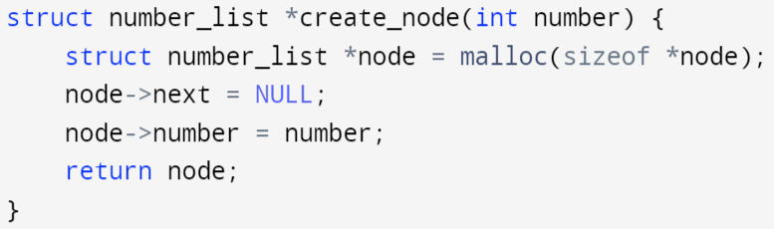
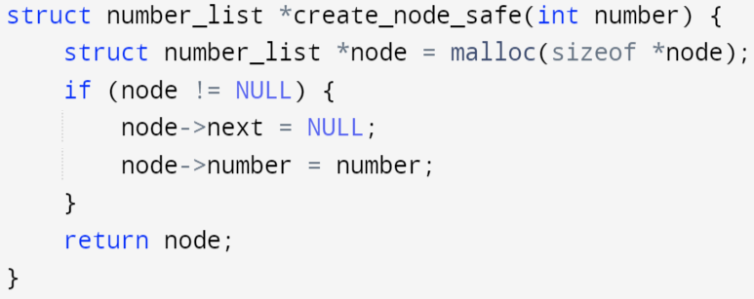
Potential issues and improvements
What if we are out of memory and malloc fails?
For dynamic memory allocation, always remember that they are not guaranteed to work! Need to check for runtime errors caused by out-of-memory issues.
Whenever you apply pointing-to (->) operator to a pointer: you need to ensure this pointer != NULL
Add a conditional expression to check if malloc is successful or not.
If successful, return new node’s address
If failed, return NULL
Need to update push_number() and insert() to accommodate this change

